Slide 1
Link State Routing Algorithm
Last Name: Ganesh
First Name : Damini
Seat No :25

Slide 2
Link State Routing Algorithm
Link State Algorithm – Description
Link State Algorithm are used in routers for getting the forwarding table based on the shortest path to all other nodes or a particular destination node.
The forwarding tables show the interface from which the packets should be sent for each and every router
To find the shortest path we use the Dijkstra's algorithm.
It finds the shortest path – distance to all the routers.
Based on which we find the connection table and the shortest path to a particular destination router.

Slide 3
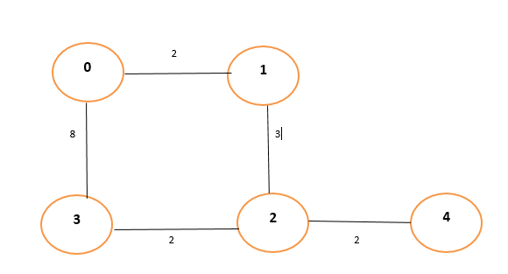
Sample Topology

Slide 4
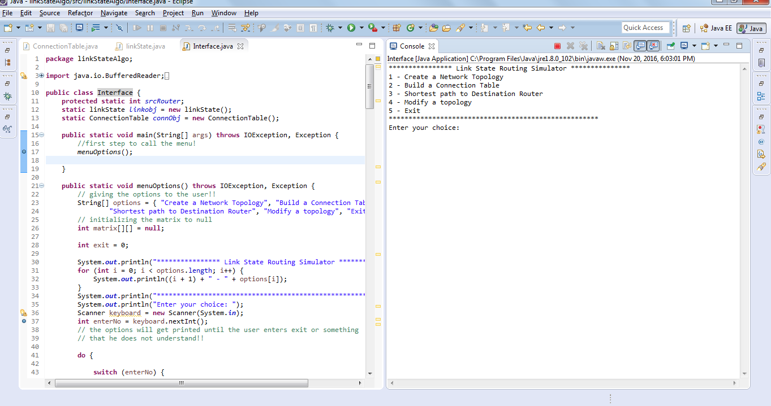

Slide 5
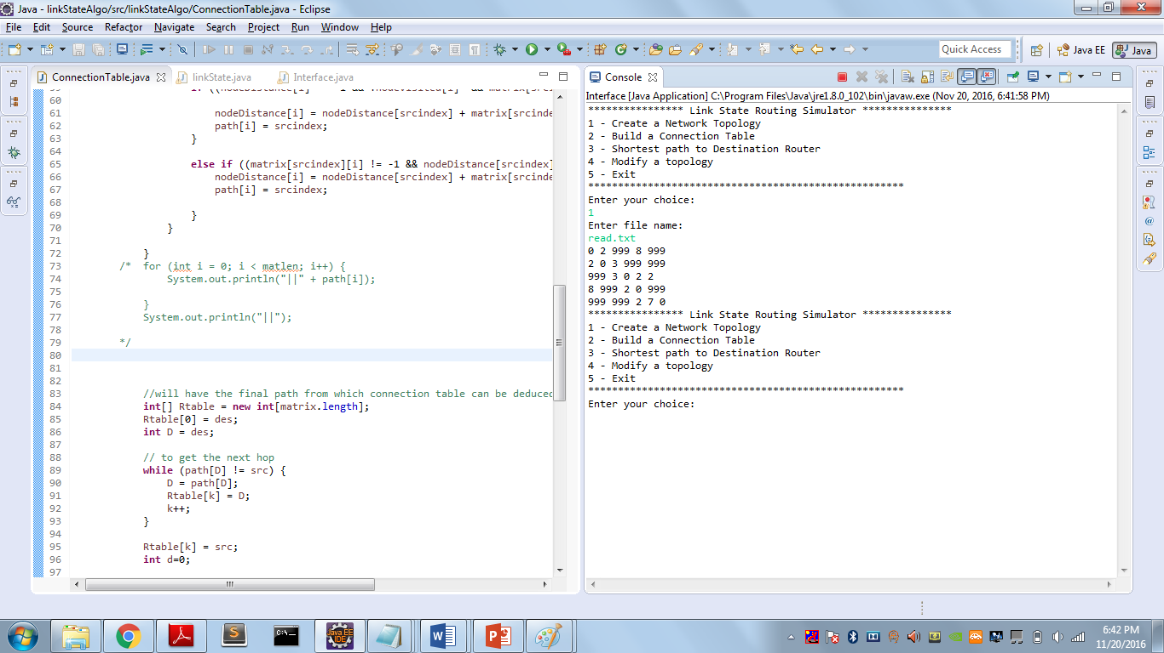

Slide 6
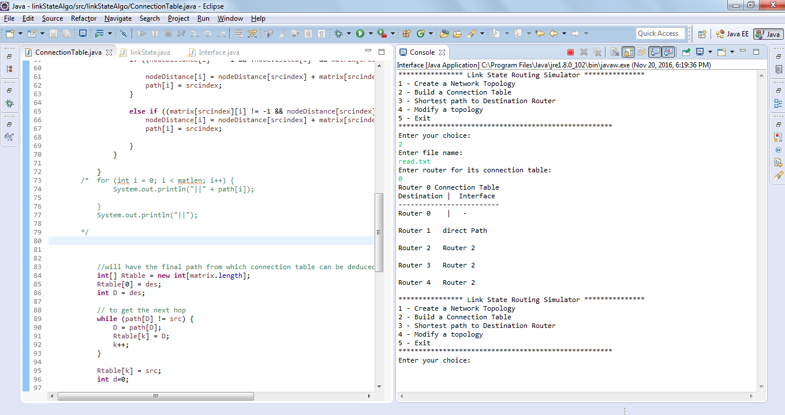

Slide 7
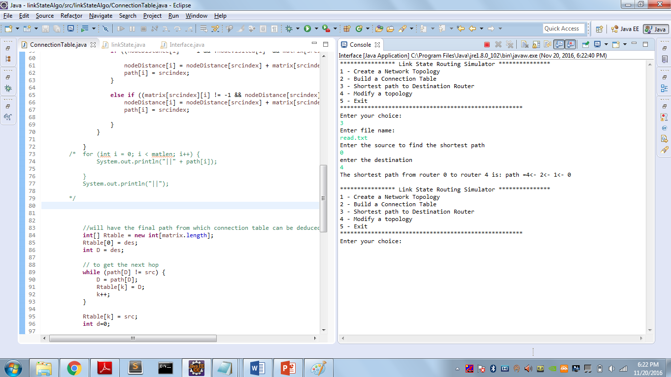

Slide 8
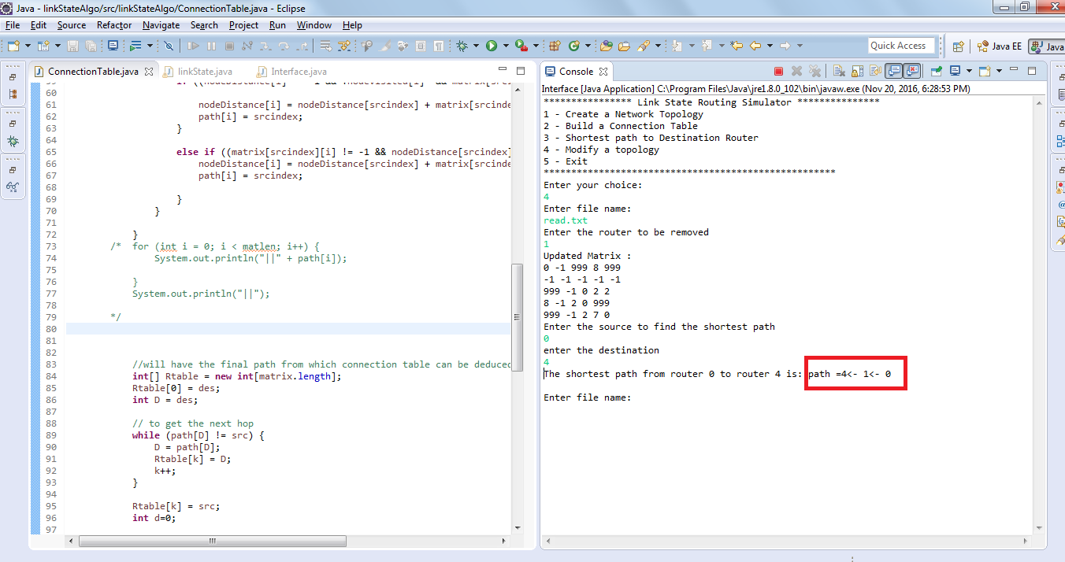

Slide 9
